Slide 1

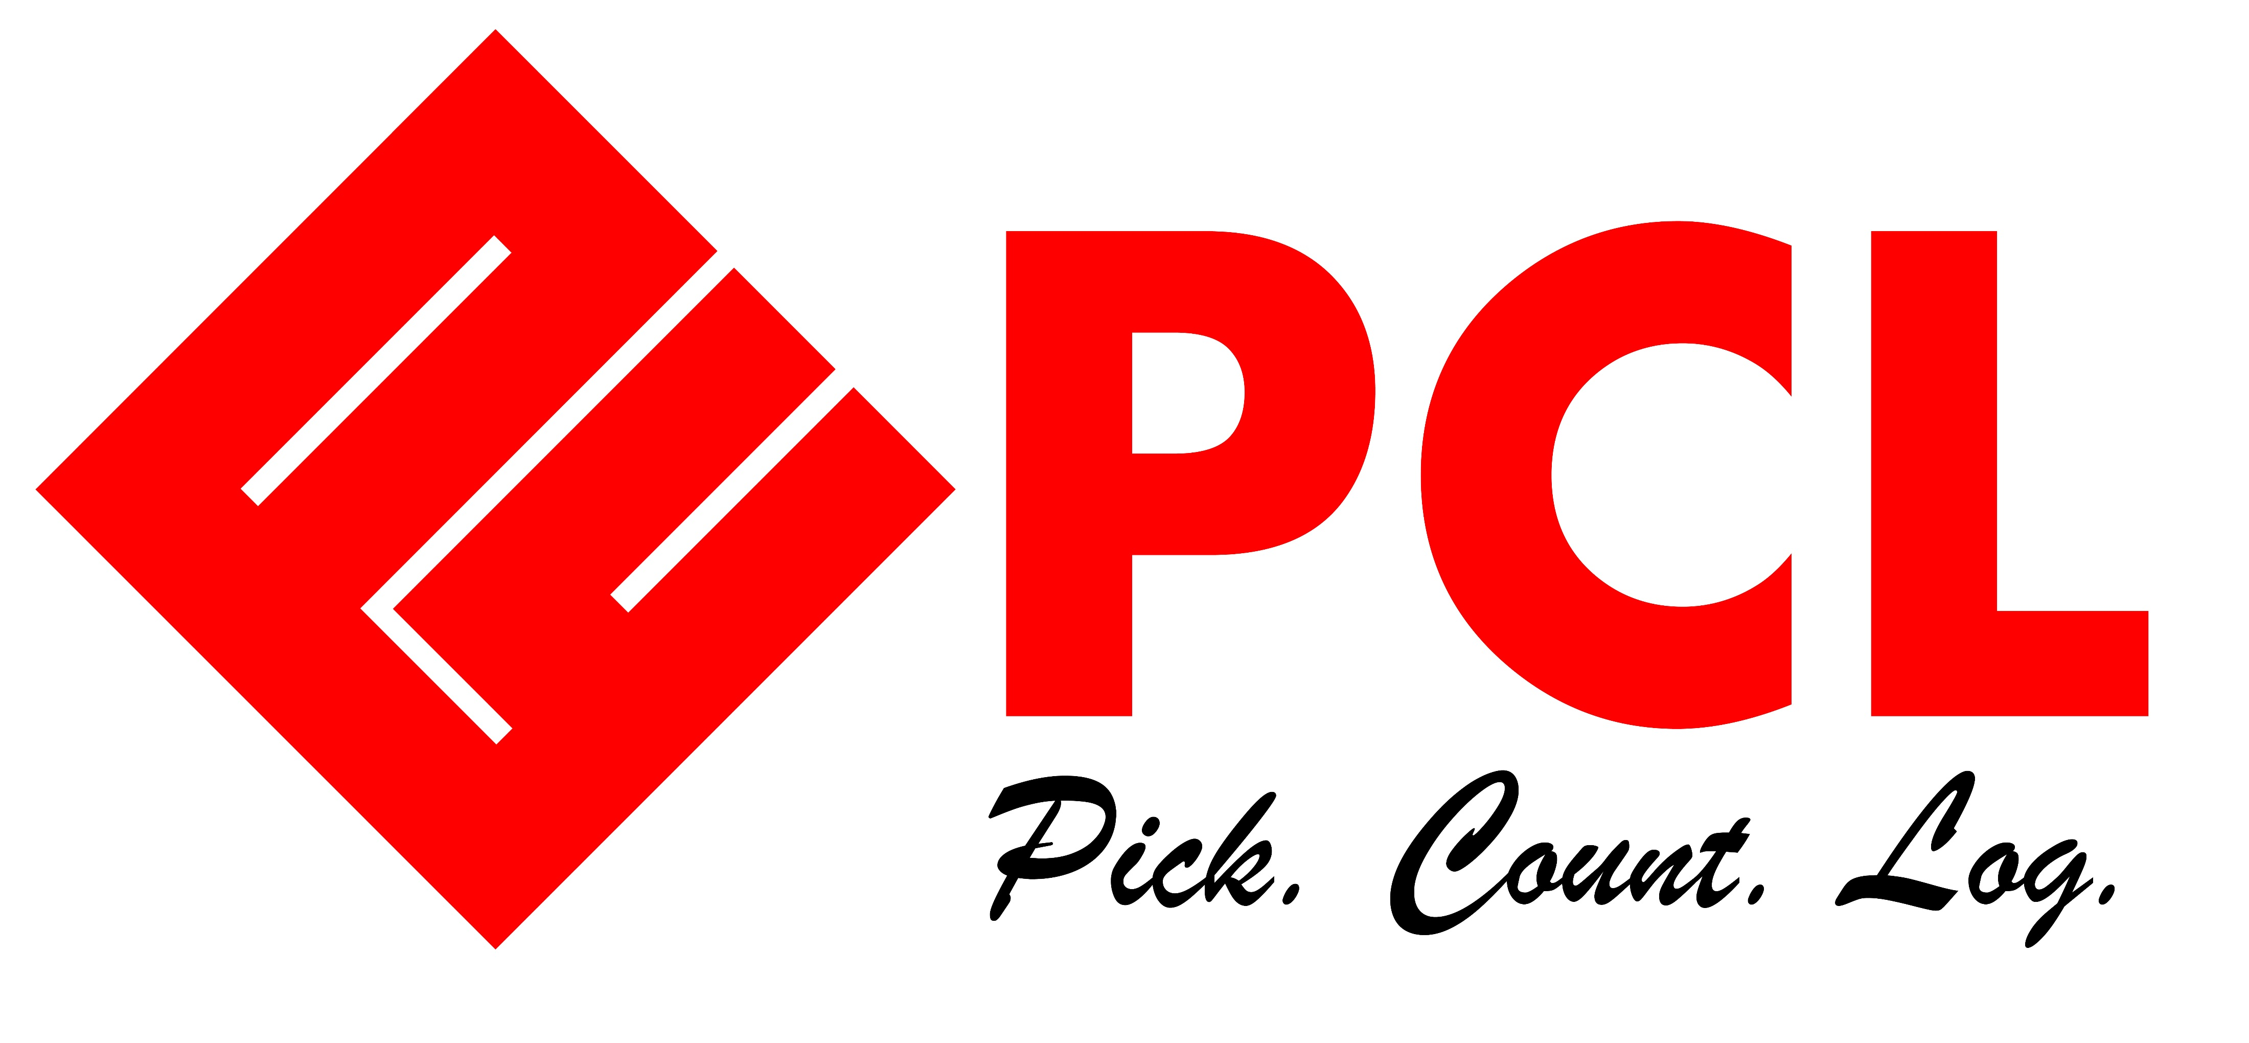
PRODUCERS CONNECTION LOGISTICS, INC.

Slide 2


“ Your active participation will make learning more interesting.”

Slide 3

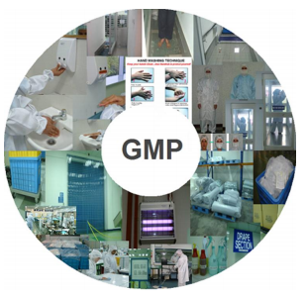
GOOD MANUFACTURING PRACTICES
GMP is a system for ensuring that products are consistently produced and controlled according to quality standard
Practices during the manufacturing of the product that will protect it from contamination
Notes:
GMP – Sa trabahong papasukan kasi natin, dapat consumer-focused din tayo. Ang pinaka goal ng GMP ay para maka-produce ng product na safe sa consumers. Hindi contaminated, malinis, or safe to use.

Slide 4
CONTAMINATION

Slide 5
CONTAMINATION
This is the presence of any foreign material in the product.
This material may be an ingredient that is not listed in its formulation, a strand of hair even a microorganism.
4 Types of Contamination / Hazard:
Chemical
Physical
Microbiological
Allergen

Slide 6


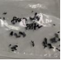
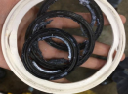
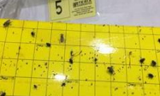
PHYSICAL CONTAMINATION
Occurs when foreign bodies are accidentally or intentionally incorporated in the product.
Physical Contaminants:
Machine parts-
bolts, nuts, gasket
Hair Strand, Finger nail
Plastics
Paper
Wood
Stone
Insects

Slide 7
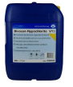
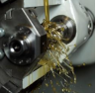

CHEMICAL CONTAMINATION
Undue or Exaggerated introduction of Chemical or Ingredients in the formulation of product
Chemical Contaminants:
Cleaning agents
Lubricants
Overdosed raw material ingredient
Wrong ingredient added

Slide 8


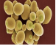
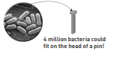

MICROBIOLOGICAL CONTAMINATION
Presence of any microorganism in the products
A microorganism or microbe is an organism which is too small to be seen by the unaided human eye. They are microscopic and found everywhere.
Types:
Bacteria
Yeasts
Moulds

Slide 9
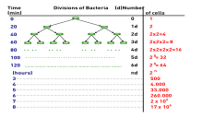
MICROBIOLOGICAL CONTAMINATION
Factors that influence microbial growth:
Time
Temperature – Cold, moderate or hot
Ph – acidic (Aw – Available water
Nutrients
Presence or absence of preservatives

Slide 10
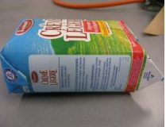
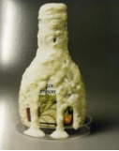
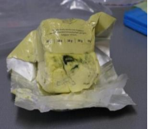
MICROBIOLOGICAL CONTAMINATION
Blown pack through bacterial contamination
Lactobacillus growth in Dressing
Mould growth in margarine

Slide 11
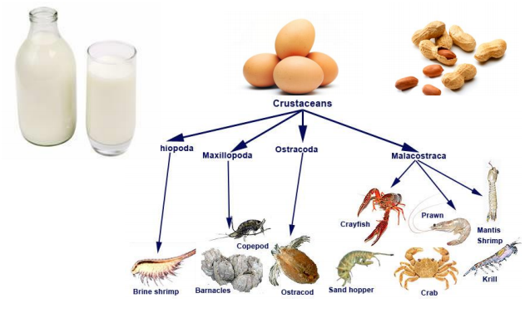
MICROBIOLOGICAL CONTAMINATION
Presence of any allergen in the products.
Common allergens “big 8”
This is the prioritized list that is considered to account for over 90% of food allergy. Based on prevalence, severity and tolerance in individuals
Peanut
Tree Nuts
SoyBean
Milk
Egg
Cereals
Sesame seed
Seafood (Fish, crustaceans, Molluscs

Slide 12


A CONTAMINATED PRODDUCT IS BAD FOR…
PRODUCT APPEARANCE
CONSUMER SAFETY
BRAND IMAGE
COMPANY IMAGE

Slide 13
GOOD MANUFACTURING
PRACTICES

Slide 14

GMP ELEMENTS
Personnel
Premises
Equipment
Sanitation & Hygiene
Production
Quality Control
Documentation
Self-Inspection and Quality Audits
Warehousing and Distribution
Product recall
Retention Of Samples
Subcontracting of Manufacture

Slide 15


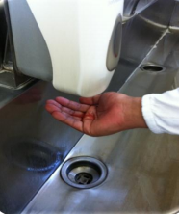
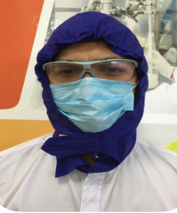
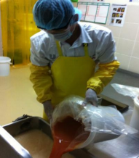
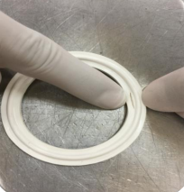
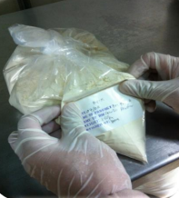
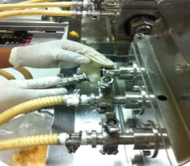
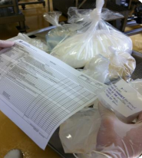
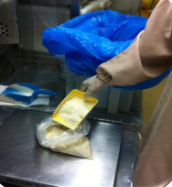
PERSONNEL
GMP Standard
Do Hand Washing
Use Approved head cover
Use proper PPEs
Do Inspection
Do proper labelling
Do cleaning and Disinfection of equipment exterior during trouble shooting
Do RM inspection
Use assigned colored scoops

Slide 16

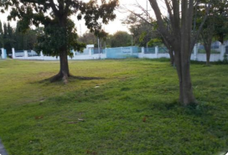
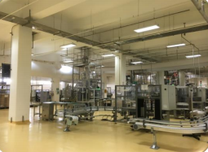
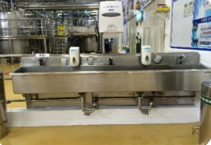
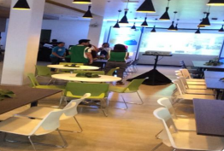
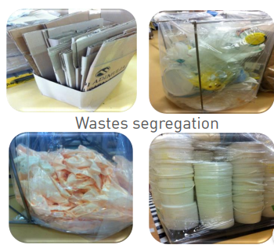
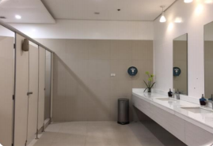
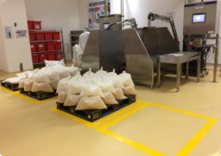
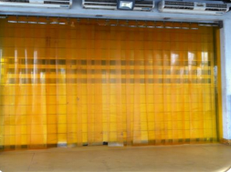
FACILITY AND BUILDINGS
GMP Standard
Clean grounds
Clean workplace
Available handwashing facility
Adequate Cafeteria
Adequate sanitary facility
Evident Workplace organization
Available pest defense

Slide 17

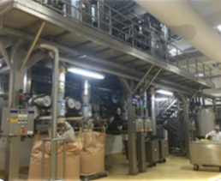
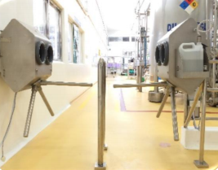
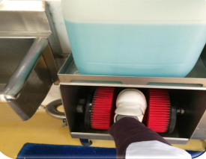
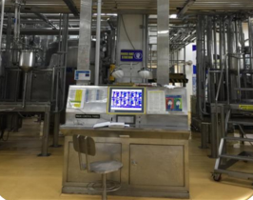
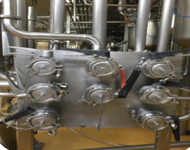
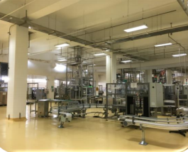
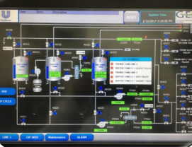
EQUIPMENT
GMP Standard
New process equipment technology
Fool proofed hand sanitation units
Shoe Cleaning units
Processing instrumentation
Pipe Installation
Powder handling filler
CIP Machine

Slide 18

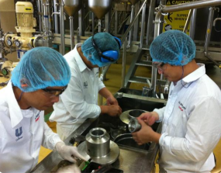
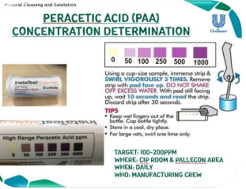
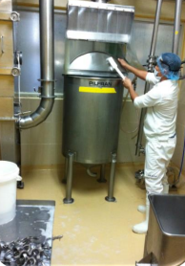
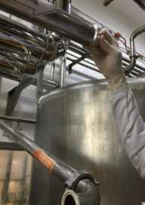
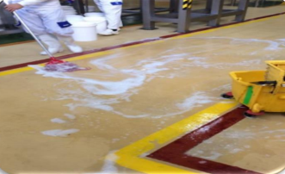
CLEANING AND DISINFECTION
GMP Standard
Do equipment PM and per defined program
Use approved cleaning chemical concentration
Do proper COP
Coordinate equipment swabbing
Do Environmental Cleaning

Slide 19

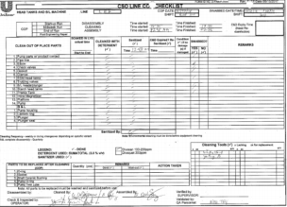
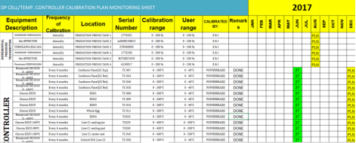
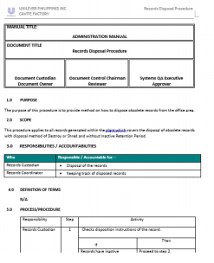
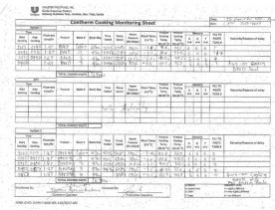
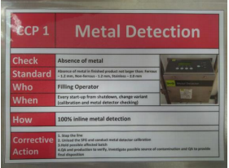
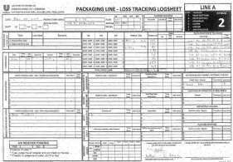
DOCUMENTS
GMP Standard
Cleaning (CIP/COP) Records
Calibration program and record
Available Standard Operating Procedure documentation
Starch cooking documentation
Filling packing documentation
CCP Monitoring and records

Slide 20

CLEANING AND DISINFECTION
Applicable standards to be followed by employees, visitors, third party…
Need to be followed by ALL
UQP 23 – PERSONNEL HYGIENE AND EMPLOYEE FACILITIES
UQP 17 – HYGIENIC ENGINEERING AND MAINTENANC
UQP 20 – CLEANING AND DISINFECTION
UQP 21 – PREVENTION OF CROSS CONTAMINATION
UQP 50 – ALLERGEN MANAGEMENT
AIMS
• Consistent quality
• Prevent contamination from personnel and facility

Slide 21

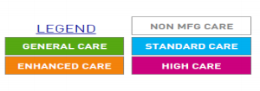
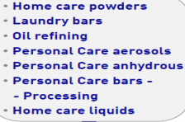





UNILEVER QUALITY STANDARDS
TYPE MANUFACTURING SITE SEGREGATION & CARE LEVELS BY TECHNOLOGY
Peanut Butter
Ready to eat chilled
Ice Cream

Slide 22
PERSONAL HYGIENE AND EMPLOYEE FACILITIES
The following requirements apply to all Non-Manufacturing areas. These are the minimum care level requirements.
All people must wash and dry hands after using toilet
• Where required by the site’s Occupational Safety Risk Assessment the following PPE must be worn:
• Safety eyeglasses - must not be be fully reflective and must fit firmly to head
• Ear plugs - must be firmly connected by a cord, string or band
• High visibility clothing - must be in a good state of repair, be visibly clean and made of non absorbent material
• Safety shoes - must fully enclose the foot (no gaps in the uppers), be clean, be appropriate for the environment and meet occupational safety requirements
• Occupational safety headwear - must be in intact and be visibly clean and must not replace hygienic headwear

Slide 23
• Gloves - must be fit for purpose, made of durable, non-toxic, non-allergenic materials, must not release toxic or allergenic substances. Gloves must never replace hand washing and should be worn only when & where occupational safety risk assessment requires it
• Dust masks - must be changed regularly (every shift or as soon as they are when dirty)
• General personal hygiene training must be completed by all personnel
• Safety and personal hygiene rules must be issued to personnel and visitors in written form and be visibly posted at entrances to manufacturing areas.

Slide 24





PERSONAL HYGIENE
The following requirements apply to manufacturing areas in ADDITION to the non manufacturing requirements already cited
General Rules
• No personal belongings and medication in the work area
• No eating, drinking & smoking outside of designated areas
• No Jewelry i.e. necklaces, rings (including wedding), piercings, bracelets, watches and other (religious) decorations.
• Short, clean nails with No false finger nails or nail polish
• No false eyelashes
• No perfume or aftershave to be worn

Slide 25


PERSONAL HYGIENE
Hygienic Head & Face Coverings
• All hair (head) must be fully covered
• Must provide head hair
• Maintain fully shaven face hair
All Work Clothing (exposed to the working environment)
• Must be visibly clean and free from odor and must be changed daily by all personnel
• Reflectorized vest must be visibly clean and in good condition
Shoes / Footwear
• Footwear must be made of non-absorbent material, fully enclose the foot and must be dry and free from visible soil

Slide 26

PERSONAL HYGIENE
Hand washing
• All personnel must wash and dry their hands before entering production areas
STANDARD HAND WASHING PROCUDURE

Slide 27


PERSONAL HYGIENE
KAILANGAN
Bago pumasok ng production – Standard Care area

Slide 28

PERSONAL HYGIENE
Health Requirements
Communicable diseases and injuries
• First aid provisions must be readily available.
• Communicable illnesses such as influenza must be reported to the line manager or designated person immediately.
• Open wounds (cuts, sores, infected areas or other wounds) must be covered completely by a protective waterproof dressing / covering.
• Dressing / covering materials must be of a colour contrasting to the products being produced
• Expert medical advice should be utilized to advise on the precautions to be taken in the event of illness or open wounds. In the absence of this, the line manager will decide on fitness to enter the manufacturing area

Slide 29

End of Presentation
THANK YOU!
Visit us
www.pcl.com.ph

